Slide 1

Capstone Project on :
TED TALKS REVIEWS PREDICTION
PRESENTED BY -
Ankit Gupta
DATA SCIENCE – ALMA BETTER

Slide 2
Index
Problem Statement
Data Summary
EDA on features
Feature Engineering
Data Cleaning
Feature Selection
Models used for training
Observation
Conclusion

Slide 3
Introduction
● TED is devoted to spreading powerful ideas on just about any topic. These datasets contain over 4,000 TED talks including transcripts in many languages Founded in 1984 by Richard Salman as a nonprofit organization that aimed at bringing experts from the fields of Technology, Entertainment, and Design together, TED Conferences have gone on to become the Mecca of ideas from virtually all walks of life.
● As of 2015, TED and its sister TEDx chapters have published more than 2000 talks for free consumption by the masses and its speaker list boasts of the likes of Al Gore, Jimmy Wales, Shahrukh Khan, and Bill Gates.
● The main objective is to build a predictive model, which could help in predicting the views of the uploaded videos on TEDx website.

Slide 4
Data Summary
Dataset name: data_ted_talks.csv
Shape: ● Rows: 4005 ● Columns: 19
Features: talk_id, title, speaker_1, all_speakers, occupations, about_speakers, recorded_date, published_date, event, native_lang, available_lang, comments, duration, Topics,related_talks, url, description, transcript
Target Variable: Views

Slide 5
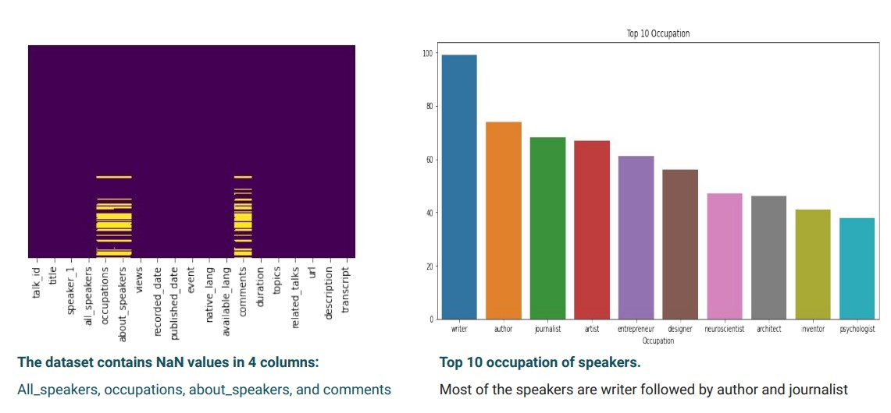
EDA on features

Slide 6
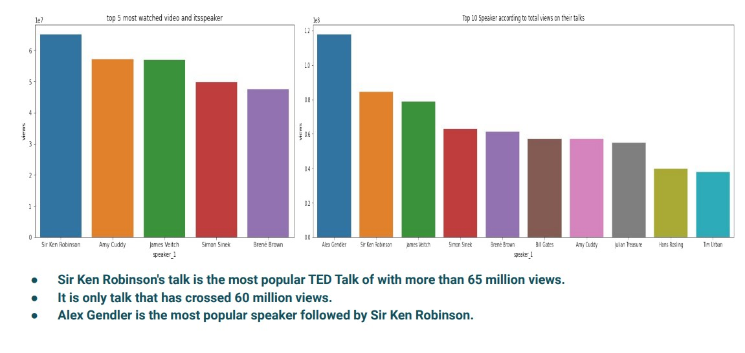
EDA on features

Slide 7
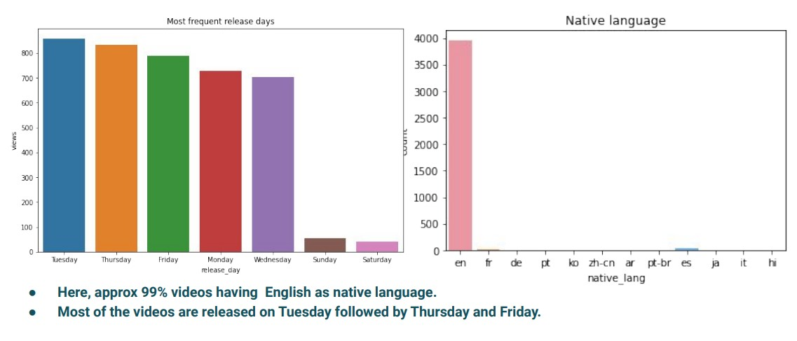
EDA on features

Slide 8
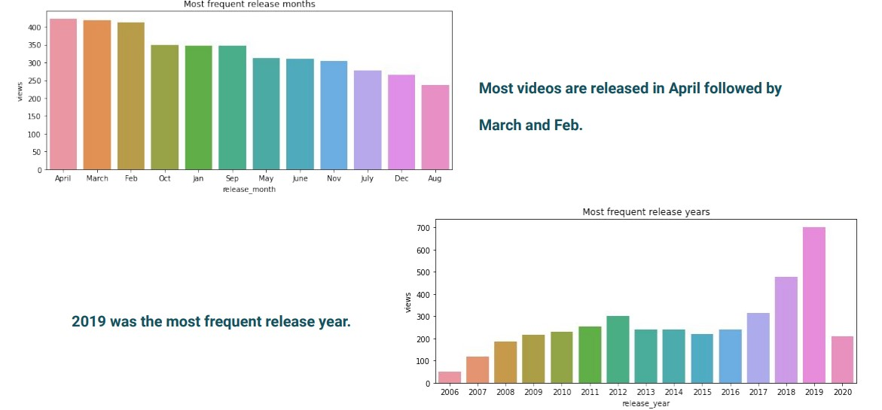
EDA on features

Slide 9
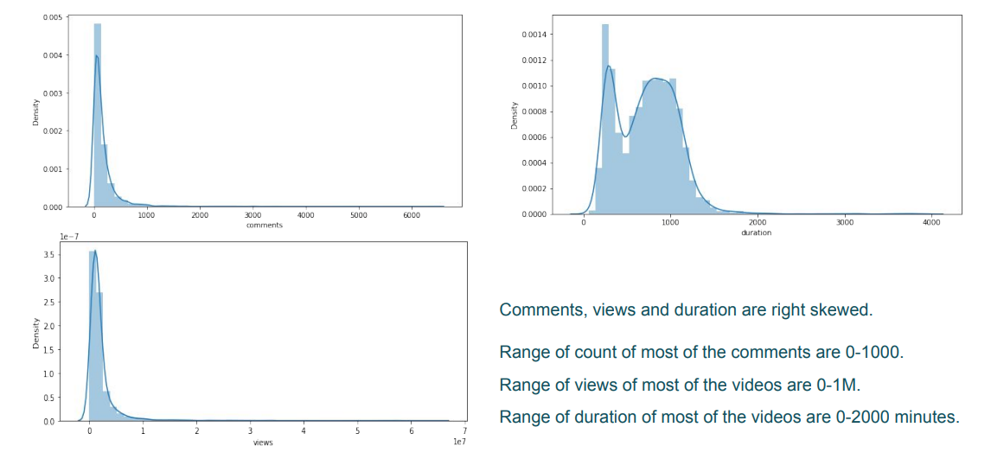
EDA on features

Slide 10
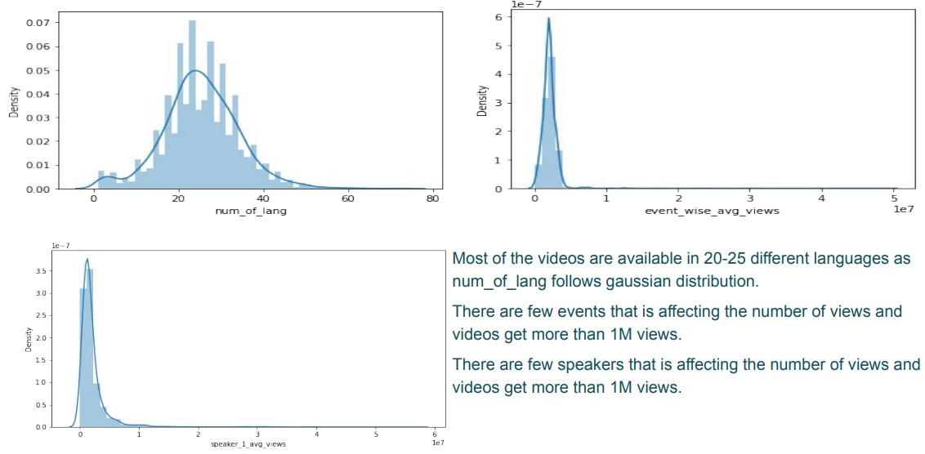
EDA on features

Slide 11
EDA on features
I did data manipulation and added some new feature for better analysis:
speaker_1_avg_views
event_wise_avg_views
num_of_lang
video_age
release_month
release_day

Slide 12
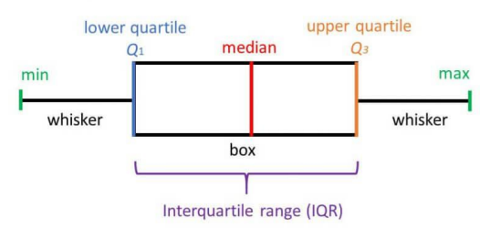
Data cleaning
Steps followed for data cleaning: 1. Replaced the NaN values of ‘Occupation’ columns with ‘Others’. 2. Replaced the NaN values of ‘comments’ column using ‘KNNImputer’. 3. Then, I handled the outliers present in columns: 'comments','duration','num_of_lang','views','speaker_1_avg_views','event_wise_avg_views' using IQR and replaced the outliers with extreme values.
IQR=Q3-Q1 Lower Bound=Q1-(1.5*IQR) Upper Bound=Q3+(1.5*IQR)

Slide 13
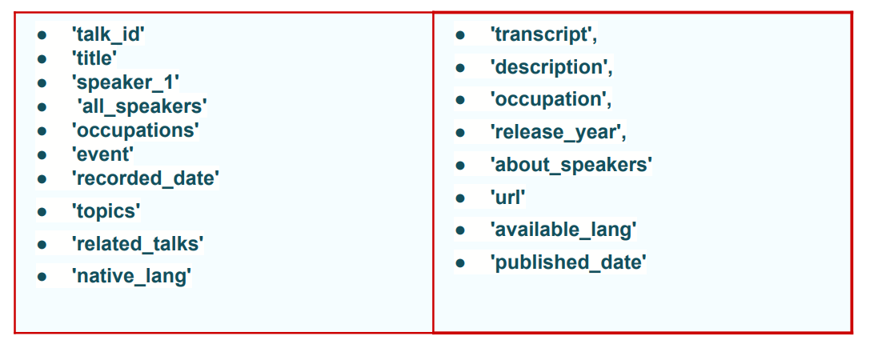
Data cleaning
After handling the outliers I removed the unnecessary columns like:

Slide 14
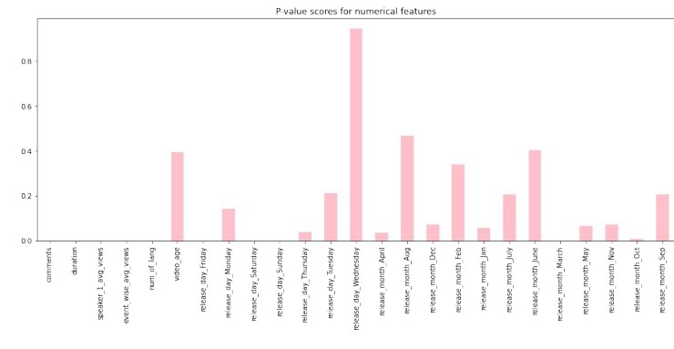
To do feature selection I used f-regression technique
After plotting p-values with features I selected the features with small p-values and leave the remaining.
Selected features: 'comments', 'duration', 'num_of_lang', 'release_day_Friday','speaker_1_avg_views', 'event_wise_avg_views

Slide 15
Models used for training
● Linear Regression
● Lasso Regression
● Ridge Regression
● Random Forest Regression
● Xgboost Regression I applied hyperparameter tuning on random forest regression and xgboost regression to get better performance.

Slide 16
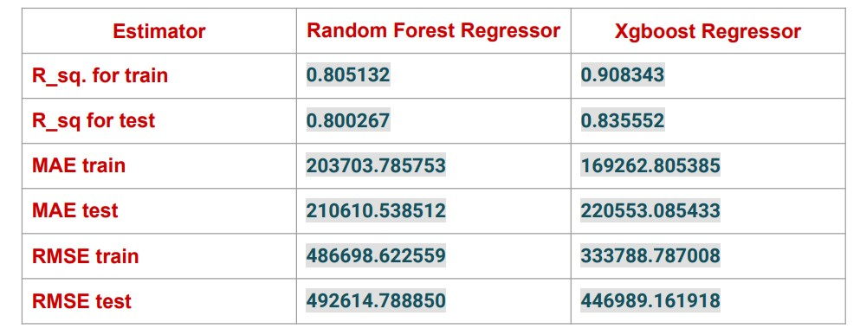
Models used for training
After hyperparameter tuning:

Slide 17
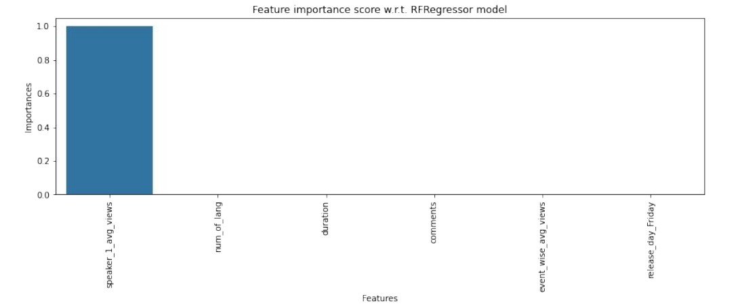
Models used for training
Feature Importance w.r.t Random Forest Regressor:

Slide 18
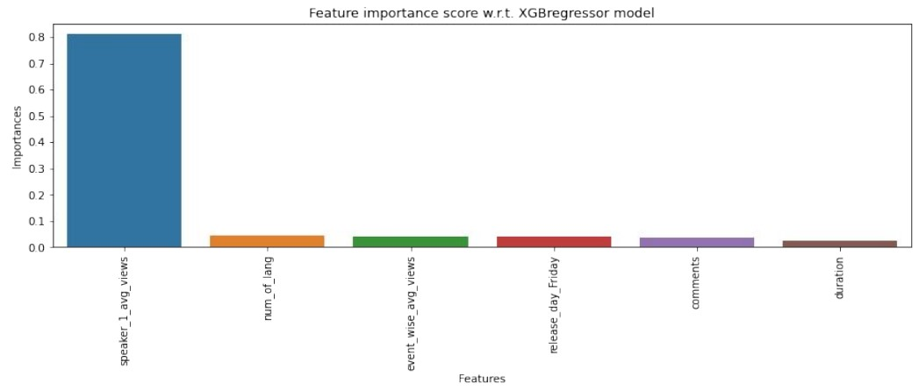
Models used for training
Feature Importance w.r.t Xg boost Regressor

Slide 19
Observation
● Out of all these models Random Forest Regressor is the best performer in terms of MAE.
● MAE is not affected by outliers.
● MAE is linear.
● In all of these models our errors have been in the range of 2,00,000 which is around 10% of the average views. We have been able to correctly predict views 90% of the time.
● After hyper parameter tuning, we have prevented overfitting and decreased errors by regularizing and reducing learning rate.
● Given that only have 10% errors, our models have performed very well on unseen data due to various factors like feature selection, correct model selection, etc.
● In all the features speaker_wise_avg_views is most important this implies that speakers are directly impacting the views.

Slide 20
Conclusion
● I built a predictive model which will help to predict the number of views for the video uploaded on TEDx website.
● TEDx can increase its views and popularity on less popular topics by inviting more popular speakers

Slide 21
THANK YOU

